Slide 1

Critical Communications in Remote Areas using LEO Satellites
YICHEN CHEN
n11564628
Major Cyber security
Cluster 6
Tutor Anisur Rahman
Supervisor Muhammad Furqan

Slide 2
Introduction
LEO (Low Earth Orbit) satellites are emerging as a solution for addressing the digital divide in remote areas.
LEO satellites offer a scalable and flexible option for overcoming connectivity issues, supporting industries like agriculture, mining, and disaster recovery.
This research focuses on developing stable LEO satellite networks in remote areas by analyzing existing solutions from peer-reviewed studies.

Slide 3
Literature Review and key findings
Review focuses on how LEO satellites can provide stable communication in remote areas, such as seas, rural regions, and mining zones.
Key challenges
Limited ground infrastructure
High power consumption
Complex satellite handovers
Solutions
Hierarchical terrestrial controller architecture (HTCA)
Increased ground station density help

Slide 4

Overall research methodology
Approach: Comparative analysis of peer-reviewed research papers
Scope: Focus on three key
Limited ground infrastructure
Power and resource limitations
Maintaining stable satellite connections

Slide 5
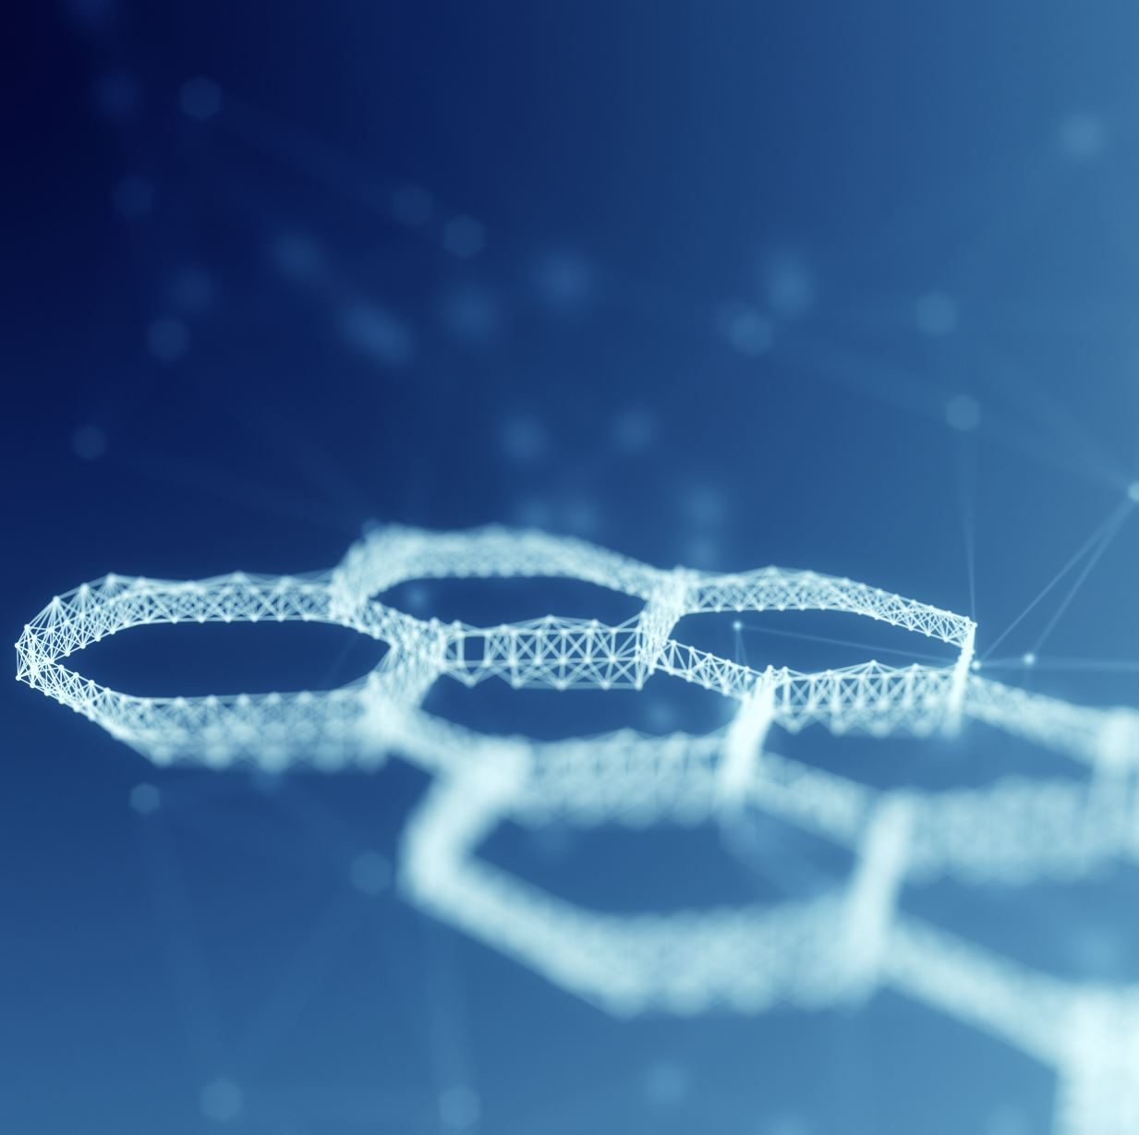
Research design, data collection, and data analysis
Design: Comparison of solutions from existing literature to address remote connectivity challenges.
Data Collection: previous studies related to LEO satellites and IoT networks in remote areas.
Analysis: Thematic analysis to evaluate the feasibility of different solutions across various environments, such as rural, sea, and mining areas.

Slide 6
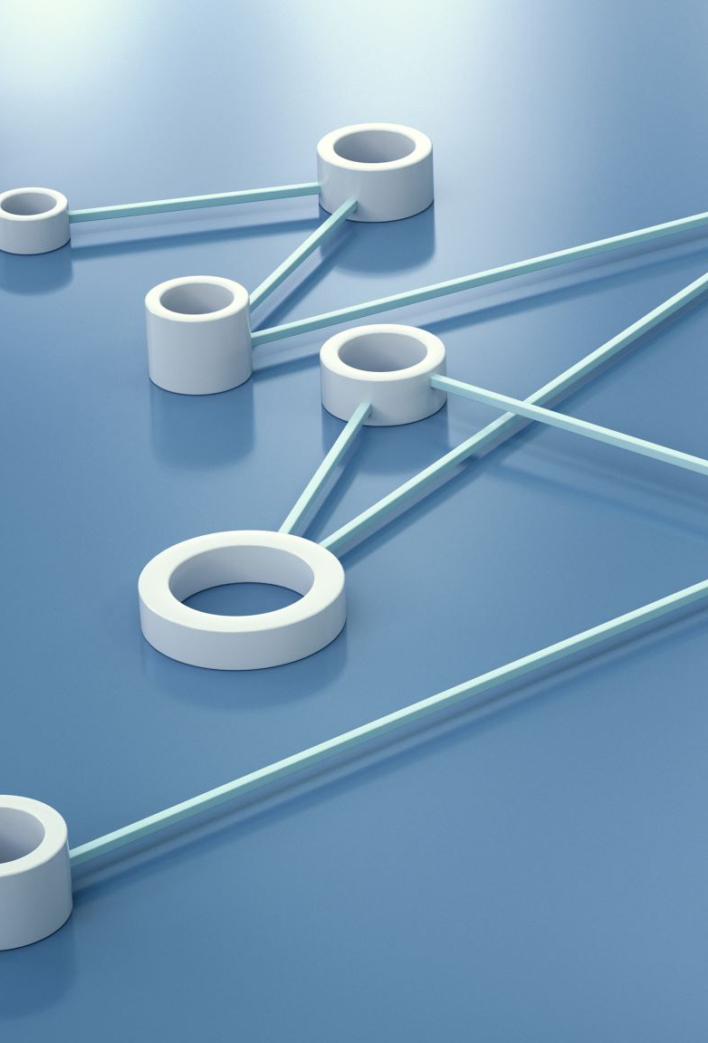
Progress summary (Data collection and processing)
Over 14 peer-reviewed studies have been reviewed, covering topics like IoT communication, data collection, and satellite-ground station connectivity.
Organized thematic insights focus on energy management, infrastructure limitations, and innovative solutions like sea-based ground stations for island nations.
New papers are still being evaluated to expand the research further, particularly for extreme geographic limitations like mountainous areas and remote mining zones.

Slide 7

Initial results
Collaborative LEO systems can lower power consumption by reducing the need for ground stations operating at high power levels.
Sea-based ground stations could be more viable for certain remote areas, such as small islands.
Practical application of these solutions will depend on the location’s specific infrastructure and power constraints.

Slide 8
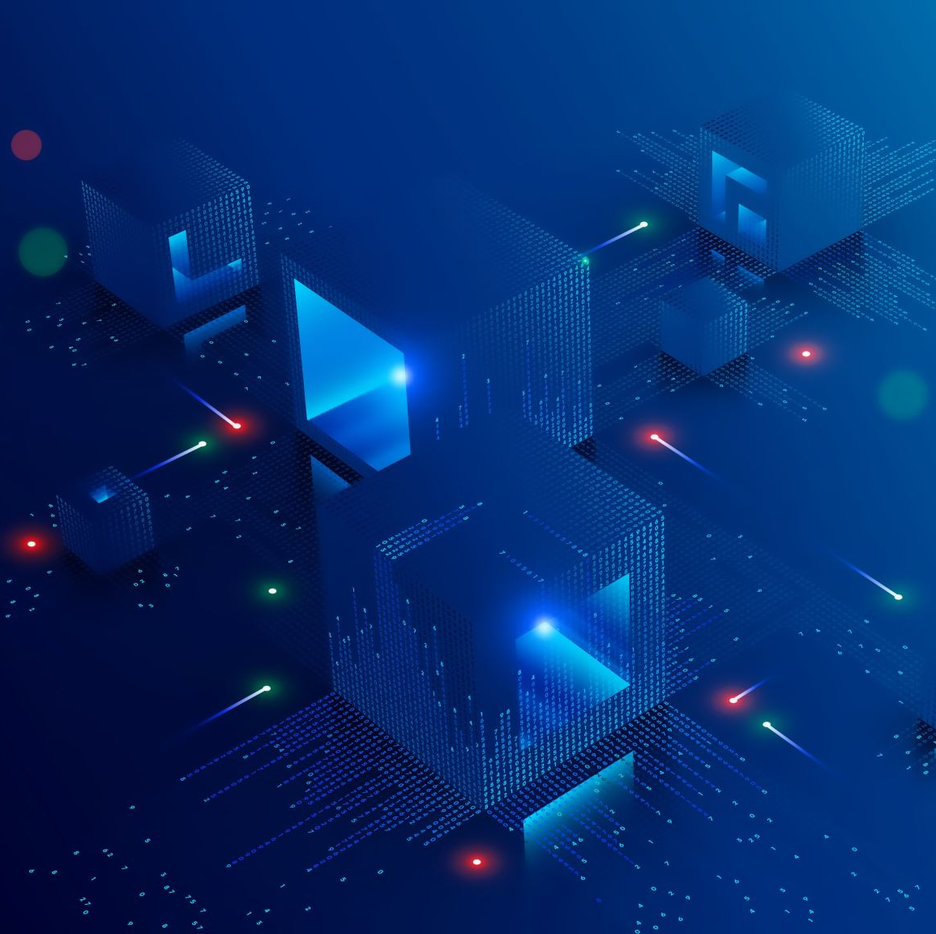
Expected outputs
Solutions for the three main challenges identified:
Infrastructure limitations: Innovative ground station setups (e.g., sea-based)
Power and resource constraints: Enhanced energy management through collaborative satellite systems and advanced solar technology
Reliable communication: Sophisticated satellite handover techniques and improved communication protocols
Future research will focus on optimizing power efficiency and enhancing reliable communication for complex IoT networks in remote areas.
Expected improvements will support industries like agriculture, mining, and rural communities globally.

Slide 9
Key Challenges and Future work
Key Challenges:
Limited Infrastructure: High costs and logistical difficulties in establishing ground stations in remote or geographically challenging areas.
Power Constraints: Limited access to reliable energy sources makes it hard to maintain satellite systems.
Communication Reliability: Ensuring stable connections requires advanced handover techniques and infrastructure.
Future Work:
Power Efficiency: Explore advanced solar and battery technologies for improved energy management.
Enhanced Protocols: Develop efficient communication protocols for IoT networks.
Geographic Solutions: Tailor solutions for specific environments, like sea-based ground stations or improved power grids in mountainous areas.

Slide 10
References
Abdi, B., Mirtalaei, S. M. M., & Ghasemi, R. (2013). EMB Charger and MPPT Merging in Micro-Satellites. International Journal of Machine Learning and Computing, 318–321. https://doi.org/10.7763/ijmlc.2013.v3.330
Ahmmed, T., Alidadi, A., Zhang, Z., Chaudhry, A. U., & Yanikomeroglu, H. (2022). The Digital Divide in Canada and the Role of LEO Satellites in Bridging the Gap. IEEE Communications Magazine, 60(6), 24–30. https://doi.org/10.1109/mcom.001.2100795
Ali, A. J., Khalily, M., Sattarzadeh, A., Massoud, A., Hasna, M. O., Khattab, T., Yurduseven, O., & Tafazolli, R. (2021). Power Budgeting of LEO Satellites: An Electrical Power System Design for 5G Missions. IEEE Access, 9, 113258–113269. https://doi.org/10.1109/access.2021.3104098
Jin, C., He, X., & Ding, X. (2019). Traffic Analysis of LEO Satellite Internet of Things. 2019 15th International Wireless Communications & Mobile Computing Conference (IWCMC). https://doi.org/10.1109/iwcmc.2019.8766604
Jin, L., Wang, L., Jin, X., Zhu, J., Duan, K., & Li, Z. (2022). Research on the Application of LEO Satellite in IOT. 2022 IEEE 2nd International Conference on Electronic Technology, Communication and Information (ICETCI). https://doi.org/10.1109/icetci55101.2022.9832117

Slide 11
References
Qiu, H., Yuting, C., Meng, Y., Fei, W., Yong, Y., Hongwei, Z., & Ni, L. (2023). Research on Reliability Improvement of Power Grid Based on 10kV Distribution Line Cross City Interconnection. 2023 5th International Conference on Electrical Engineering and Control Technologies (CEECT). https://doi.org/10.1109/ceect59667.2023.10420586
Su, Y., Liu, Y., Zhou, Y., Yuan, J., Cao, H., & Shi, J. (2019). Broadband LEO Satellite Communications: Architectures and Key Technologies. IEEE Wireless Communications, 26(2), 55–61. https://doi.org/10.1109/mwc.2019.1800299
Xia, D., Zheng, X., Duan, P., Wang, C., Liu, L., & Ma, H. (2019). Ground-Station Based Software-Defined LEO Satellite Networks. https://doi.org/10.1109/icpads47876.2019.00102
Yue, P., Du, J., Zhang, R., Ding, H., Wang, S., & An, J. (2023). Collaborative LEO Satellites for Secure and Green Internet of Remote Things. IEEE Internet of Things Journal, 10(11), 9283–9294. https://doi.org/10.1109/jiot.2022.3223913

